Slide 1
Alma Analytics folder structure
Yoel Kortick – Senior Librarian

Slide 2
Introduction
Analytics contains folders that
Provide the user with out-of-the-box reports that are not editable.
Provide a space to save locally created and edit reports.
There are separate folders for reports which the institution may want to make available
For other users in the institution
Only for the logged-in user
For any institution in the Alma community

Slide 3
Folders
My Folders = A read / write personal folder accessible only to the logged in user.
Alma, Leganto, etc = Read-only folders containing out-of-the-box reports produced by Ex Libris.
Name of Institution = A folder which is read / write and visible to anyone in the institution who has “Designs Analytics” role (and can thus click the “Design Analytics” entry in the Alma menu)
Community = A read / write folder visible and accessible to save and copy reports for all institutions. Includes reports and dashboards of all the institutions with Ex Libris Analytics in the world. It contains only queries (no data of other institutions is visible).

Slide 4
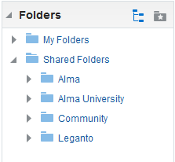
Folders
In this example the name of the institution is “Alma University”.

Slide 5
Folders
Reports and dashboards which are in the read-only folders Alma, Leganto, etc can either be used “as is” or edited for local use.
See How to edit and change a default Alma Analytics dashboard

Slide 6
xxx@exlibrisgroup.com

